Slide 1
The Wind is Still Blowing
Rev. David Maier
(Workbook Page 19)

Slide 2
THE WIND IS STILL BLOWING
Rev. Dr. David P. E. Maier

Slide 3
THE WIND IS STILL BLOWING
No one sews a patch of unshrunk cloth on an old garment. If he does, the new piece will pull away from the old, making the tear worse. And no one pours new wine into old wineskins. If he does, the wine will burst the skins, and both the wine and the wineskins will be ruined. No, he pours new wine into new wineskins. Mark 2:21-22 NIV

Slide 4
THE WIND IS STILL BLOWING
Jesus answered, “How can the guests of the bridegroom fast while he is with them? They cannot, so long as they have him with them. But the time will come when the bridegroom will be taken from them, and on that day they will fast.” Mark 2:19-20 NIV

Slide 5
THE WIND IS STILL BLOWING
The doctrine of grace and faith and the power-filled Gospel life that springs from it cannot possibly be combined, even in small part, with Pharisaic Judaism.

Slide 6
THE WIND IS STILL BLOWING
Jesus’ second illustration completes the thought. “And no one puts new wine into old wineskins; otherwise the wine will burst the wineskins, and the wine is lost and the wineskins.”
The old cannot be kept by adding a little of the new; still less by combining all of the new with it.

Slide 7
THE WIND IS STILL BLOWING
Jesus was bringing into being the reality for which the Temple had been one of the great advance signposts: God’s sovereign and saving presence in the midst of his people. This was a time for looking forward to the great things God was beginning to do.

Slide 8
THE WIND IS STILL BLOWING
When God is doing new things, we should join the party, not grumble because the new wine is threatening to burst our poor old “bottles.”

Slide 9
THE WIND IS STILL BLOWING
Friends, Jesus was, from the very beginning, continually preparing His disciples for the NEW He was bringing and for the CONTINUING work of the Holy Spirit.

Slide 10
THE WIND IS STILL BLOWING
Luke 5: 1-11
John 21: 1-14

Slide 11
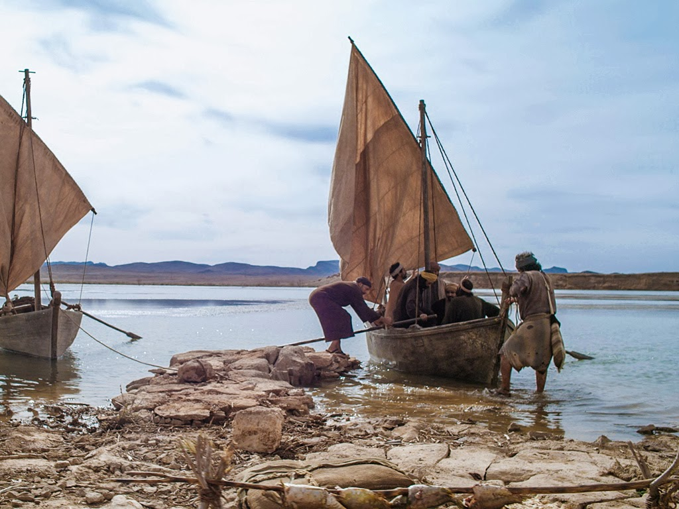
THE WIND IS STILL BLOWING

Slide 12
THE WIND IS STILL BLOWING
“Who could see that the mountains of ignorance were removed, that the flinty hearts were made like butter by contrition, that the new, immortal spiritual life of faith was coming into existence, that the frightful, crushing guilt and sin were blown away as far as the east is from the west? Spiritual things are invisible, nobody's eyes see that they are wrought. Therefore even preachers often think that their work is in vain.

Slide 13
THE WIND IS STILL BLOWING
And how could Peter and the apostles face Judaism and paganism with absolute assurance of victory when they had only the Word? Here was the visible answer: the nets full of fish caught at Jesus' word, and at that word alone. So the net of the gospel would become filled to the top. These gospel fishermen would most assuredly succeed.”
RCH Lenski, Commentary on Luke

Slide 14
THE WIND IS STILL BLOWING
The weakness of our believing and of our preaching lies in not taking Jesus altogether at his Word.

Slide 15
THE WIND IS STILL BLOWING
“Put out into the deep” … challenges us to consider the ‘unconventional’ and ‘untraditional’ ways and places – even in the eyes of the world – whereby we will continue to be fishers of men … while ALWAYS holding on to the Word of God, the Word that is truth (John 17:17); the Word that is God’s power unto salvation (Romans 1:16), and the NEW work of the Holy Spirit that attends the Word.

Slide 16
THE WIND IS STILL BLOWING
There would be the change in ministry direction: It would no longer be …
centripetal… where all the important things move or tend to move toward the center – Jerusalem; but rather now
centrifugal… where the important work of ministry would move away from the center … for Jesus said, “you shall receive power when the Holy Spirit has come upon you; and you shall be My witnesses both in Jerusalem, and in all Judea and Samaria, and even to the remotest part of the earth.” Acts 1:8

Slide 17
THE WIND IS STILL BLOWING
Here’s the truth we should embrace:
being Christian exiles in American culture is just the continuing story of God’s children over the past centuries and millennia who found themselves “exiles” in whatever “foreign” place they were living; and …
being Christian exiles in American culture does not end our influence; but, “it takes the swagger out of it.”

Slide 18
THE WIND IS STILL BLOWING
We must take both our theology and our culture seriously.
If we take only our theology seriously, we have the tendency to retreat into enclaves, to barricade ourselves behind bunkers (or fortresses, if you prefer), and become, in effect, an ethnic group of like-minded and behaved people and mistake that like-mindedness for faithfulness.

Slide 19
THE WIND IS STILL BLOWING
We must take both our theology and our culture seriously.
If we take only culture seriously, we will so relativize and water down the Word of God that our proclamation will be little more than empty assurances that “God loves you” and admonitions to “be good to one another.”

Slide 20
THE WIND IS STILL BLOWING
But by taking both seriously we, in ongoing dialectic with our other-cultured brothers and sisters, press our theological understandings to ascertain how these eternal truths are contextually relevant and work to discover authentic Christian responses to the Living Word of God.
Properly Dividing: Distinguishing the Variables of Culture from the Constants of Theology or It’s Not How You Look, It’s How you Think You Look by Dr. Jack M. Schultz

Slide 21
THE WIND IS STILL BLOWING
“If you were isolated on a desert island, and could only have one book, one volume, which one would you have?”
G. K. Chesterton

Slide 22
THE WIND IS STILL BLOWING
Practically speaking, how do we “put out into the deep”… TODAY?

Slide 23
THE WIND IS STILL BLOWING
We can love because God first loved us.
1 John 4: 19

Slide 24
THE WIND IS STILL BLOWING
As someone who has been filled with strong, sacrificial, bold, pure, Christ-like love, give yourself to those you are to love.

Slide 25
THE WIND IS STILL BLOWING
Coast Guard Motto: “We have to go out; We don’t have to come back!”

